Slide 1
INC109682818 Cannot create a VCE service version of 55810644
23-Jan-2026

Slide 2
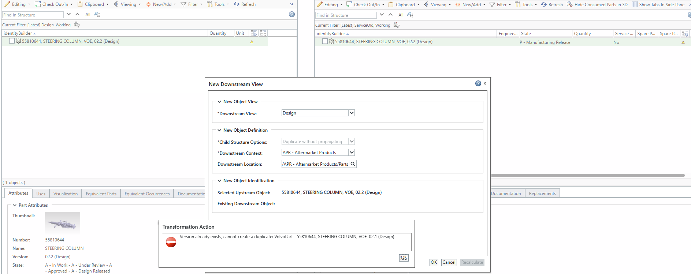
Issue details:
The below error is notice when we have Design view at both the ends in Service Associative Part Structure Browser

Slide 3
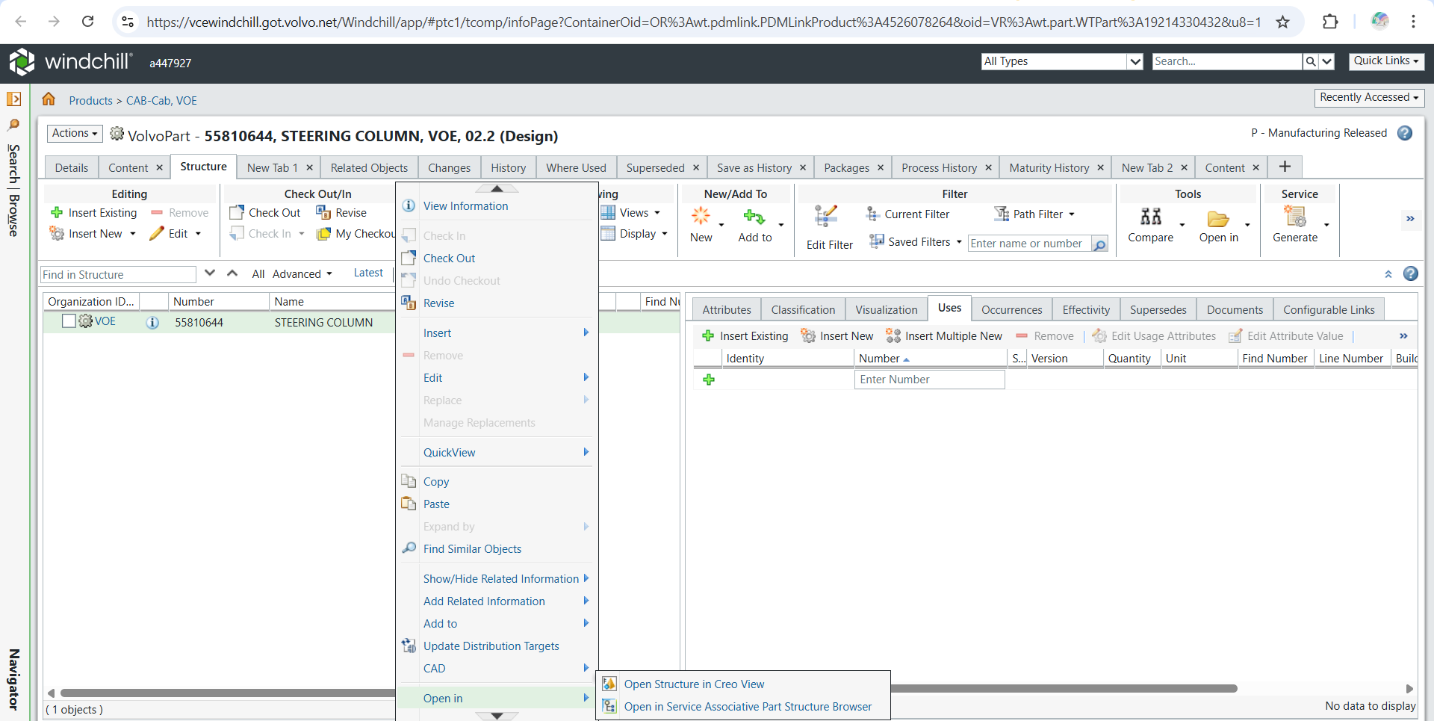
Click the right mouse button

Slide 4
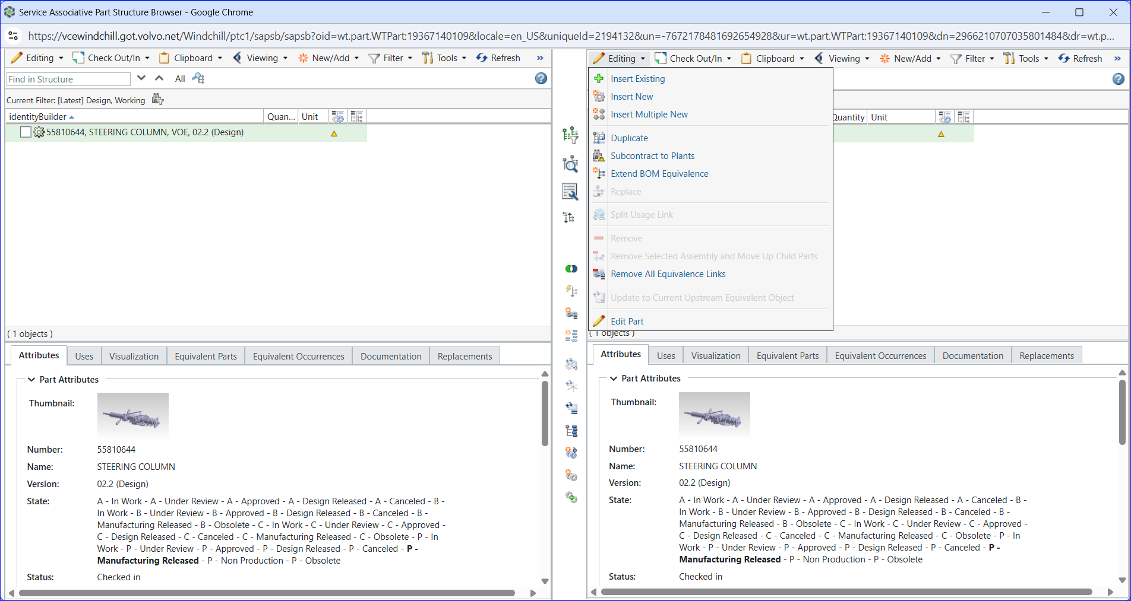
1
Open the Service Associative Part Structure Browser
2
3
Select Remove All Equivalence Links

Slide 5
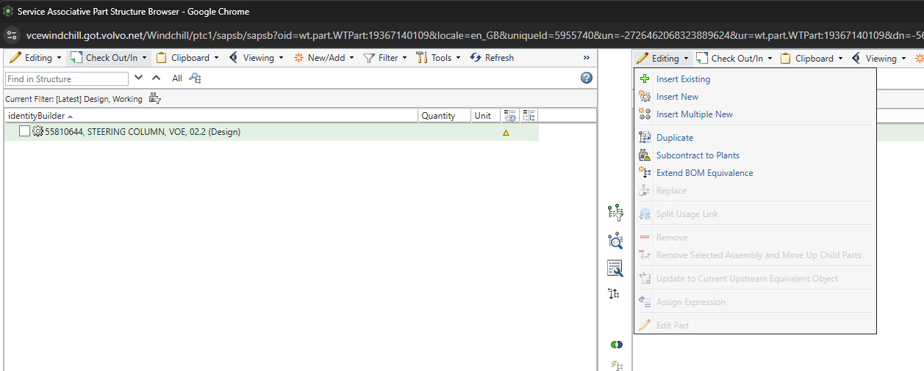

Slide 6
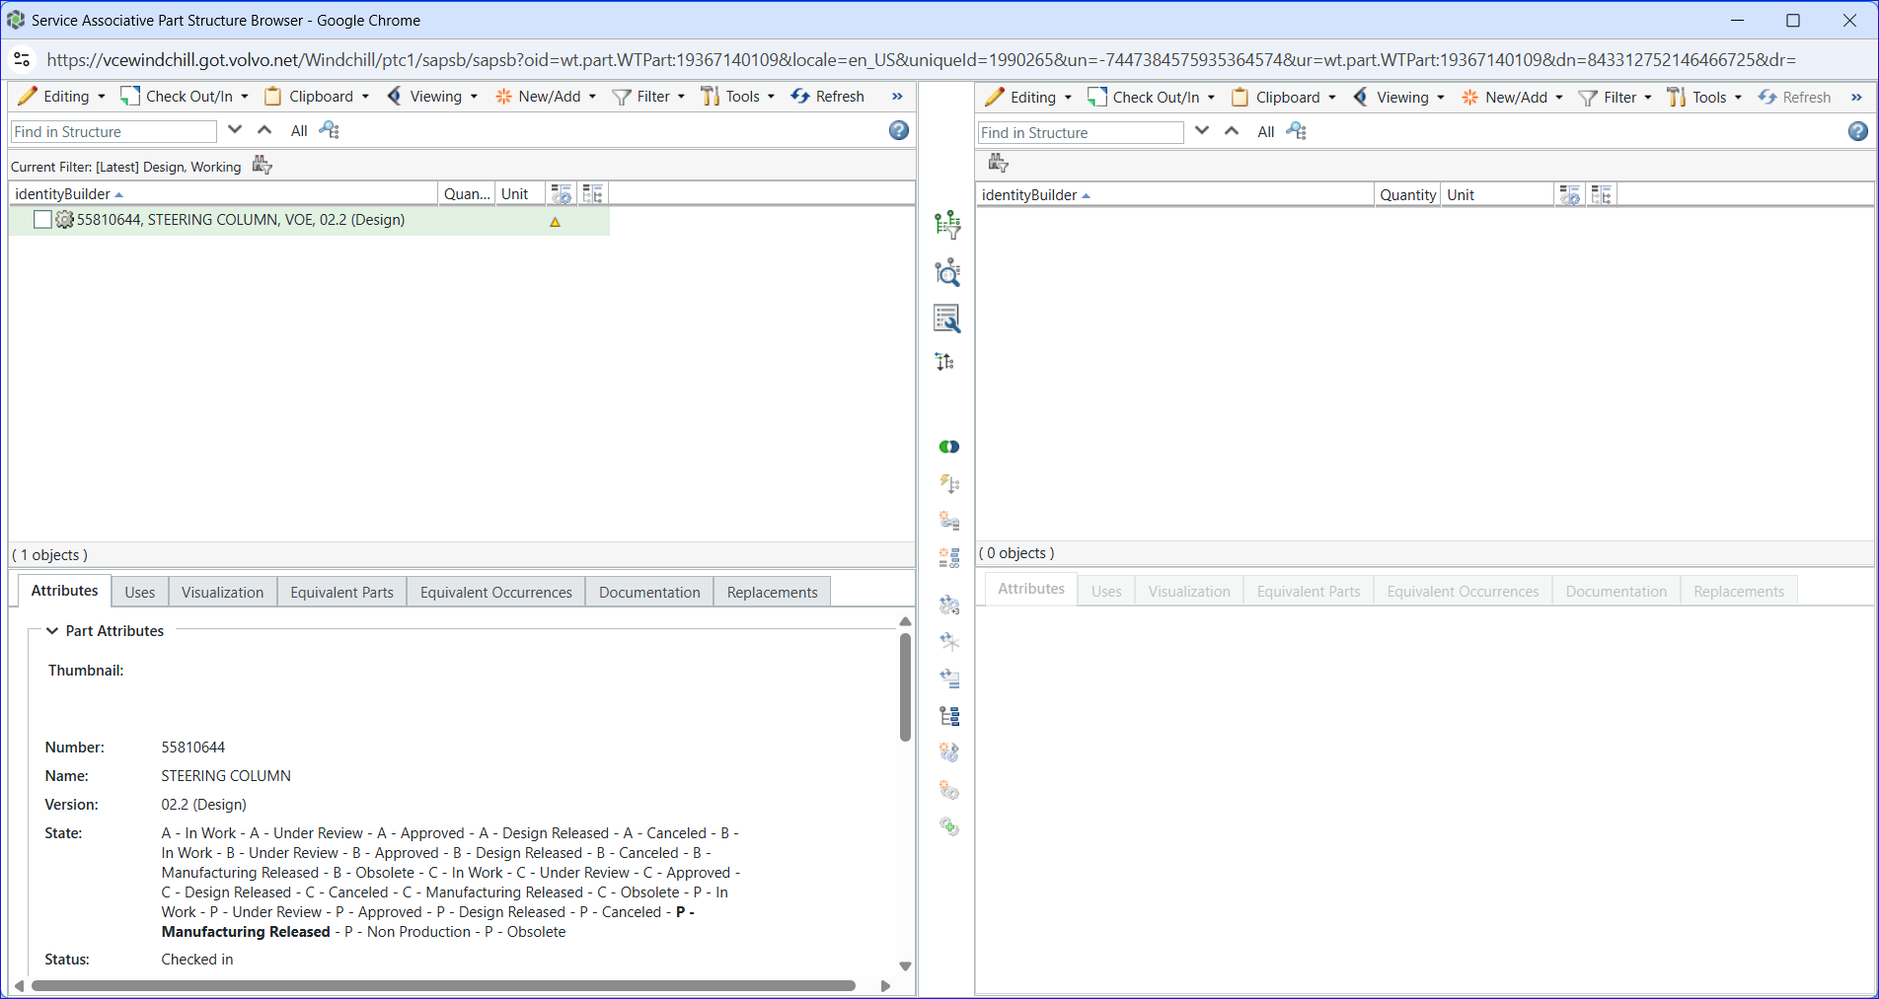
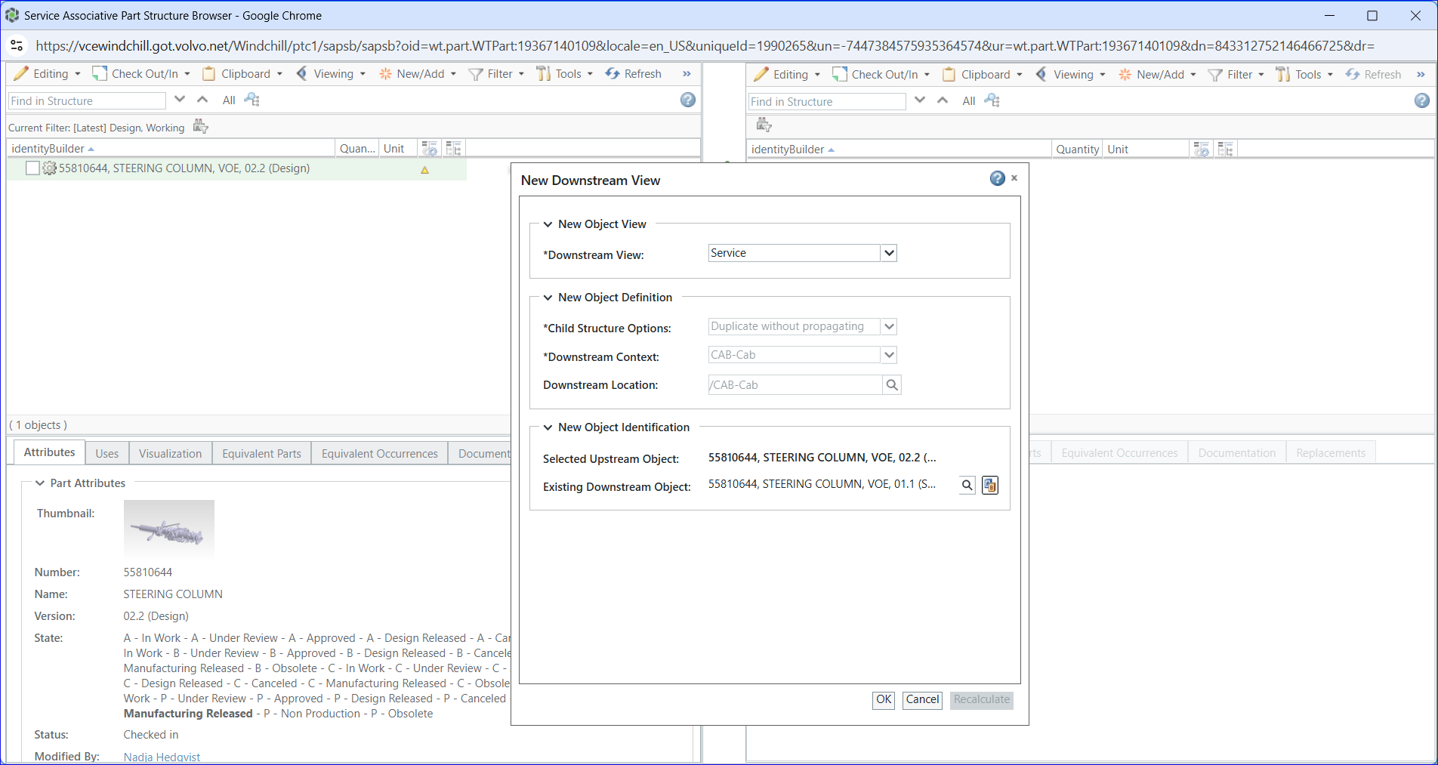
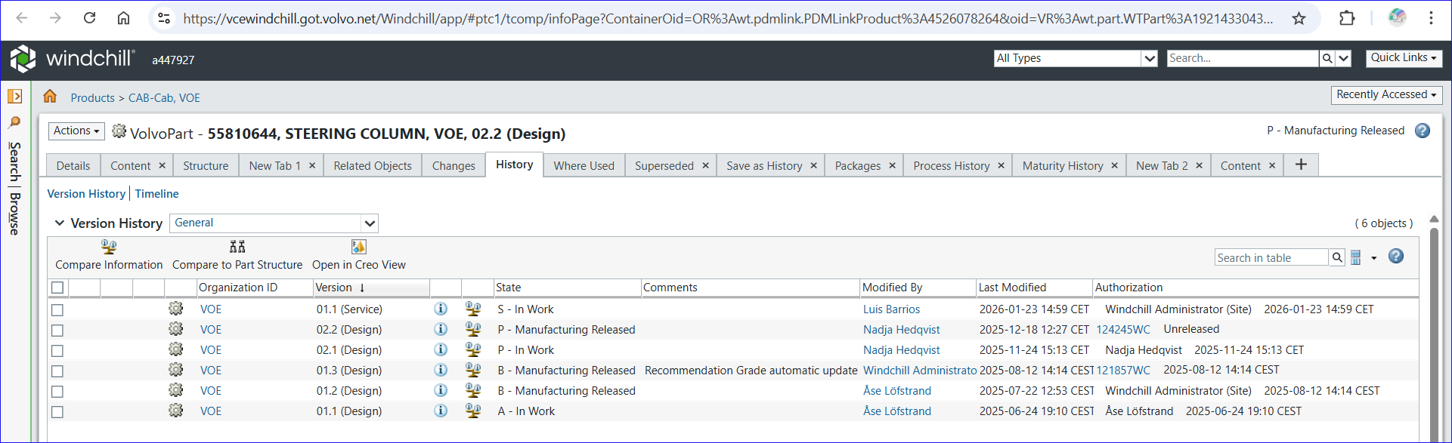

Slide 7
INC109682818 Cannot create a VCE service version of 55810644
22-Jan-2026

Slide 8
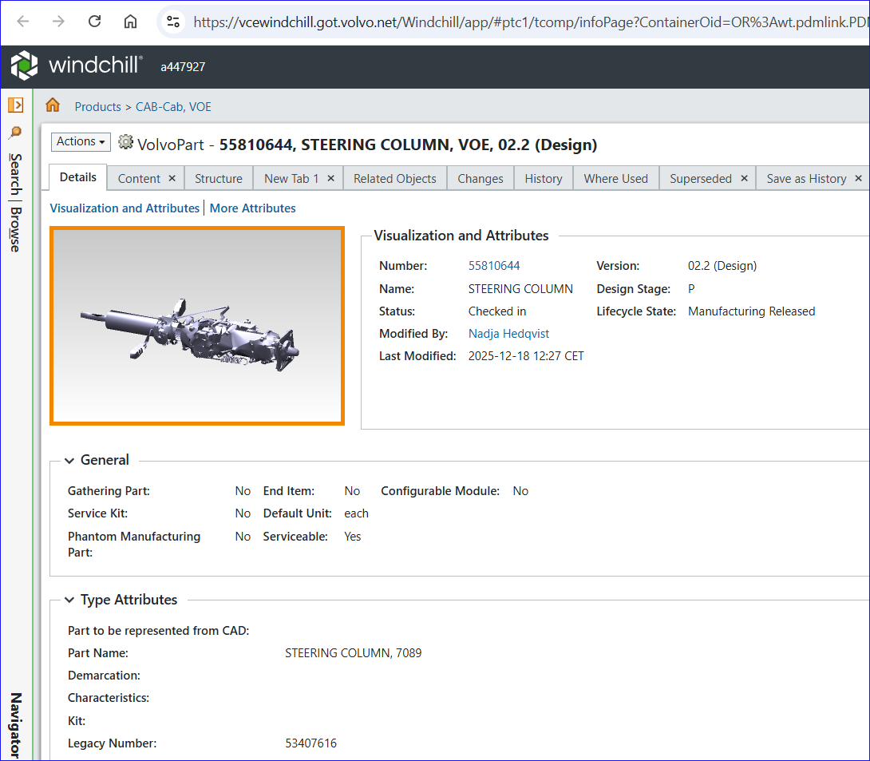
55810644

Slide 9
